Slide 1
Research of Physics Games

Slide 2

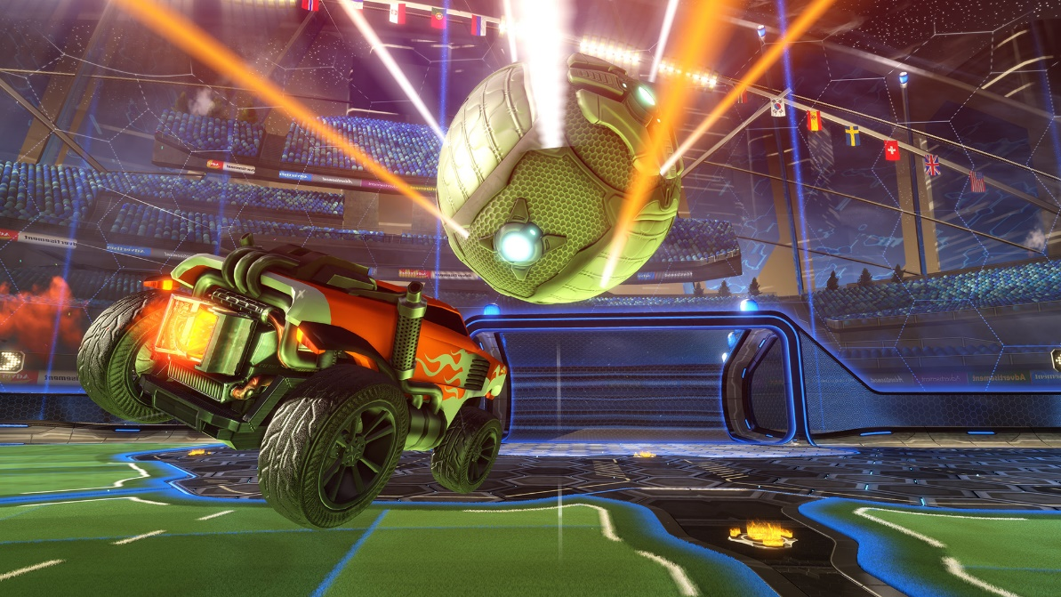
Rocket league
Rocket league is a game played using the cars controlled by the
Player, in which two teams fight over one ball and use the momentum and direction of their car to score in the opposing net.

Slide 3

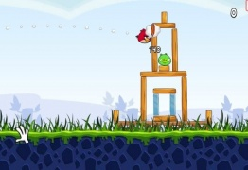
Angry Birds
Angry Birds is a game in which you have to use precision to hit objects, using the pull of your finger. The player is flung out of a catapult and the aim of the game is to hit all the pigs which are on that level.

Slide 4

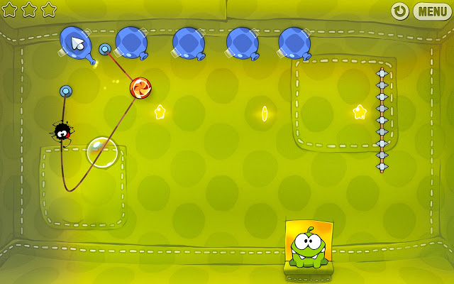
Cut the rope
Cut the rope is an app game in which you have to get a piece of candy into an animals mouth using momentum and problem solving. The player does this by swiping the screen at the right moment.

